Slide 1
Best Premier League Team
Jack Pope

Slide 2
Introduction
The Premier League is the top tier of English football. It has been around since 1992, when it had 22 teams.
It now has 20 teams, with the three lowest placed teams relegated at the end of the season, and three new teams replacing them.
There is lots of discussion about the best team in England throughout history. Some uses for knowing this could include:
  Sports journalism and trivia
  Measuring team dominance
  Which team a player should join
I am going to provide an answer to the question of:
Which Premier League team has spent the most time as the best team in the league?

Slide 3
Contents
01. The Data
02. The Model
Overview of the data and how I dealt with it.
How the model is designed, tuned and validated.
03. Results
04. Limitations
05. Next steps
Summary and all-time values.
Where the model is lacking.
Improvements and other uses for the model.

Slide 4
The Data
Input Data
Prepared Data
33 CSV Premier League season files
One row per match with: date, home/away teams and goals at full time.
More, sometimes sparse data such as bookmaker odds, referee, cards, shots, fouls, corners
Inconsistent formatting across seasons
Read files defensively
Standardised formatting
Converted bookmaker odds into average probabilities
Kept only relevant data (dates, teams, goals, bookmaker odds)

Slide 5


Elo Model
Expectation
Parameters
$E=\frac{1}{1+exp(−{\frac{h_elo − a_elo+home_adv}{173.7}})}$
k: tunes general change per game
p: goal diff exponent
Home advantage
Home win: 1.0
Draw: 0.5
Away win: 0.0
Update Formula
$$Δ=k⋅(1+{\left|\text{goal} \text{diff}\right|)}^{p}⋅\left(Actual−E\right)$$

Slide 6

Elo Model: Tuning
Tuning
Elo Parameters
$$RPS=\frac{1}{2}\left[{\left(p_{H}−o_{H}\right)}^{2}+{\left(p_{H}+p_{D}−o_{H}−o_{D}\right)}^{2}\right]$$
k: tunes general change per game
p: goal diff exponent
Home advantage
Home advantage rate: adjusts home advantage each season
Carry over: how much rating teams that stay up keep
Promoted Elo
Run coordinate-wise hill climbing over a discrete grid.
Curve Parameters
Scale: how the rating gap affects confidence
Draw width: how likely a draw is

Slide 7

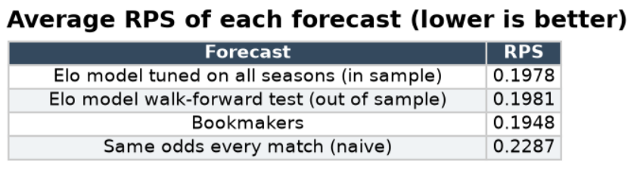
Elo Model: Validation
Walk forward test
I ran a walk forward test, predicting each season using only previous seasons. I compare how the RPS found in this test compares to the bookmakers’ RPS, by evaluating how much of the gap between a naïve baseline (historical H/D/A%) to the bookmakers that Elo closes.

Slide 8
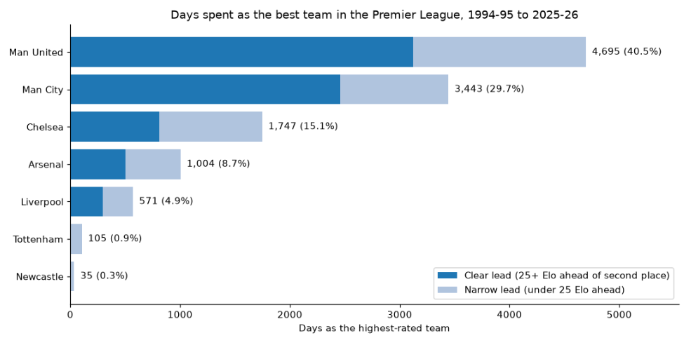
Elo Results

Slide 9
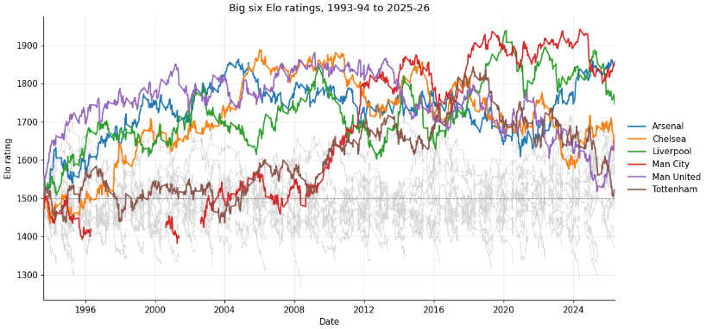
Elo Results

Slide 10
Limitations and improvements
More data
xG Elo Model
Include injuries, signings, schedules, referees, managers etc
Instead train a model based off the results that would be expected by xG.
Attendance vs Home Advantage
More games
Live prediction
Test whether attendance affects performance like home advantage does.
Test whether including European fixtures improves predictive power.
Use the model to predict future results

Slide 11
Questions?

